Slide 1
TELEVISION

Slide 2
Have you ever seen Aurora Borealis?
Have you ever been to the ocean?
Have you ever heard the roar of the lion?

Slide 3
Can you be in all these places and see all these wonders without leaving the house?
- Switch on your TV!
The answer is simple!

Slide 4
Do you know that ……..
Listen to the text and answer the questions :
Who was John Lodge Burd?
What was the name of the first TV set in Russia?
When was the first film appeared?

Slide 5
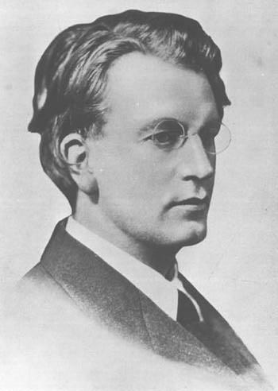
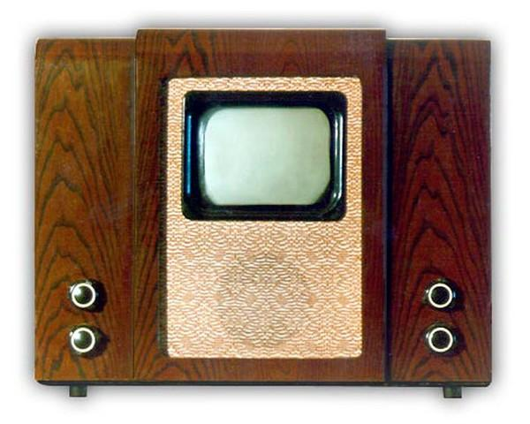
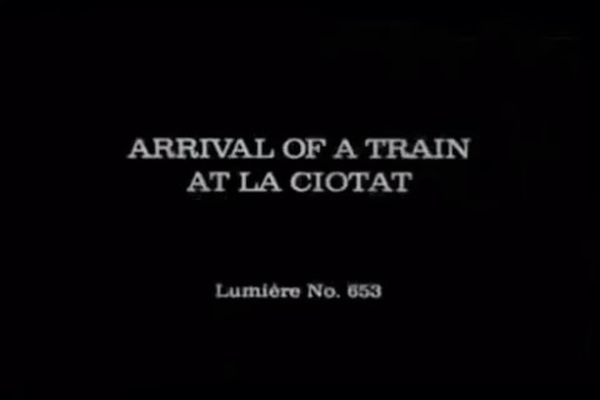
A Scottish man John Lodge Burd was the first who demonstrated a TV set
“ KVN-49” was the first Russian TV set
In 1895 the Lumier brothers demonstrated the first three minute film “Arrival of the train”.

Slide 7
comedies
dramas
cartoons
action films
news programme
thrillers
science fiction films
game shows

Slide 8
the news
a programme where a team or one person compete to win
serial
a programme that is based on facts and history ( about people, art, inventions, nature)
game show
a programme about the latest events and politics
documentary
a group of programmes on one topic
talk show
a long drama or a comedy that is broadcast in parts

Slide 9
I like watching …….
I enjoy watching ….
I can’t say that I like watching …….
I don’t mind watching …
I hate watching ….
…….because it helps me relax
…..because I can get useful information for …….
……because it’s not very intelligent
…….because I think it’s better ……
…as it is very exciting to watch…
…because sometimes you can see curious things there

Slide 10
Hello! This is the electronic assistant of the Dolphin Sports Club. We kindly ask you to take part in our survey. We need to find out how important TV is nowadays. Please answer six questions. The survey is anonymous – you don’t have to give your name. So, let’s get started.

Slide 11
1. Have you got a TV set at home?( How many TV sets have you got at home?)

Slide 12
2. How many TV channels do you have on your TV?

Slide 13
3. Have you got a favourite TV programme?

Slide 14
4. Do you get a lot of information from television?

Slide 15
5. Are you a telly addict?

Slide 16
6. What TV programme would you advice to watch to your foreign friend?

Slide 17
This is the end of the survey. Thank you very much for your cooperation.

Slide 18
Write an essay on the following
There is nothing better than watching TV
People spend more and more time watching TV. Almost every family has a TV set……..
Personally, I think that television has many benefits. Firstly,….. Secondary,…..
However, some people believe that TV has some serious drawbacks.
All in all, it is difficult to imagine life without TV. It …….but ………..

