Slide 1
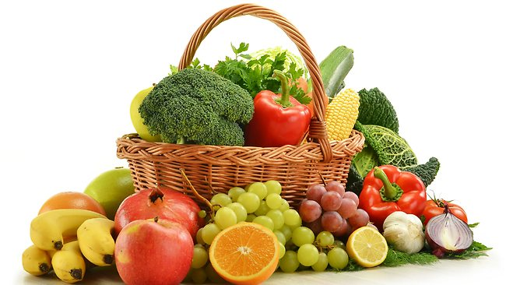
THEME: FOOD

Slide 2
eating habits
What do you like eating?
Do you think you eat healthy food?
Do you eat junk food? How often?

Slide 3
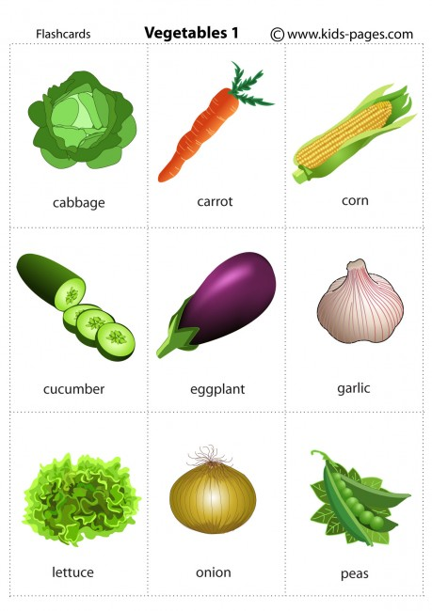
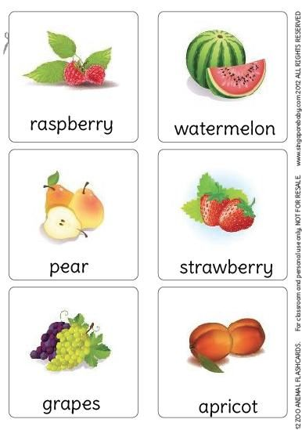
name the vegetables and fruit which you can see in the pictures

Slide 4
Look at the layout of the text. What type of text is it?

Slide 5
Read again and tick
 | protect against cancer | protect against heart disease | help you to have healthy eyes | help you have a good memory
Dark blue grapes
Blueberries
Peppers
Oranges
Tomatoes
Carrots

Slide 6
Read the dialogues (1-3) and draw your attention to the words in bold.
1. Write fruit and vegetables help keep our ____healthy.
a. eyes b. heart
2. The man and woman don’t need to buy any______.
a. strawberries b. cherries
3. The man orders ______ for dessert.
a. a fruit salad b. ice cream

Slide 7
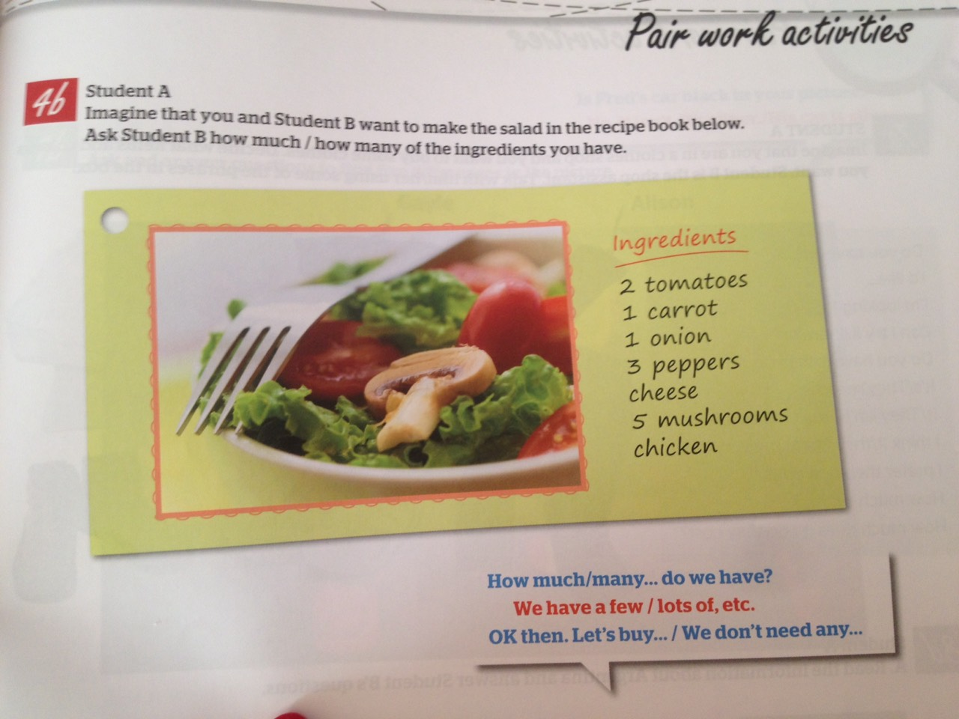
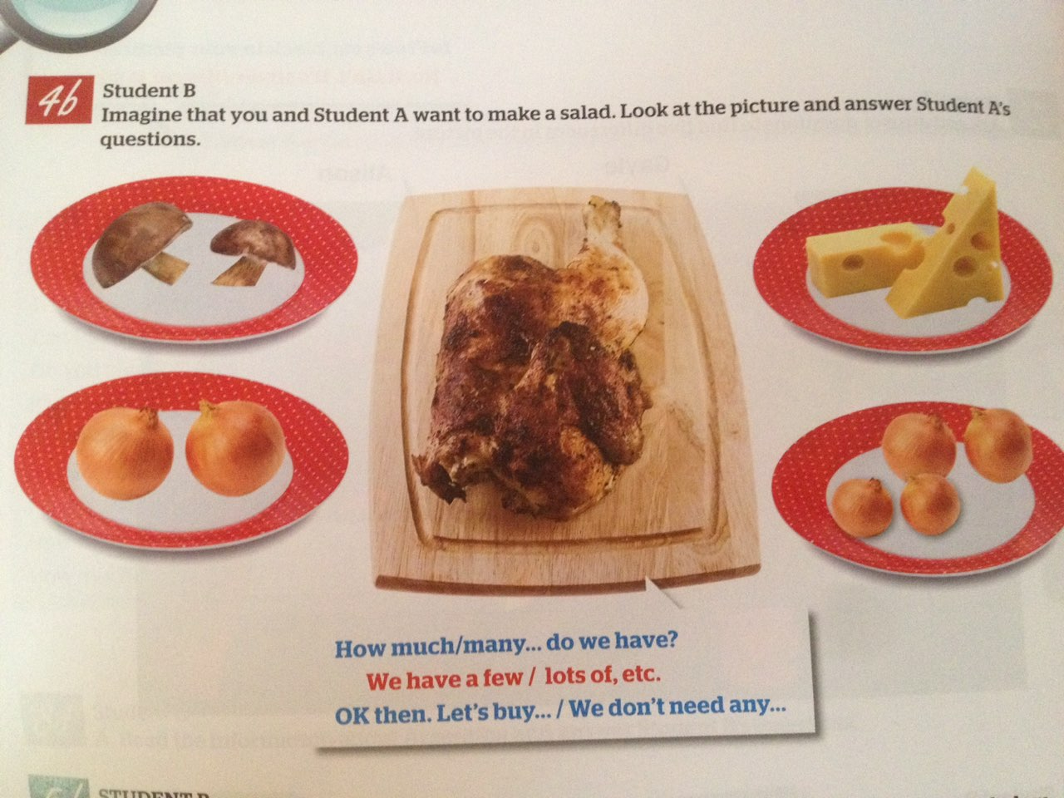
Look at the pictures and read through the speech bubles. In pairs discuss as in the example.

Slide 8
Thank you for your attention.
Good Bye

